Slide 1
GameOn!
A site made for Gamers.
Presented by: Group 4
Zainab Akubat
Richard Hall
Mozzam Khan

Slide 2
What is it?
A website that will offer a “one stop shop”. Gamers will no longer need to roam the internet hoping to find relevant information they require for their game of choice.
Our website, GameOn, is an all inclusive web site that contains information about video games. We have a games catalog, a news article section, and a newsletter subscription service in development. Once a customer is registered, they will have the ability to view all of the services.

Slide 3
Benefits of GameOn!
The benefit of GameOn is that we strive to build a community of gamers who share in the gaming experience, building a network of trusted peers within the gaming community.
GameOn will provide a closed community of gamers without the fear of flaming or spam, This will be moderated by our community log in membership requirement.

Slide 4
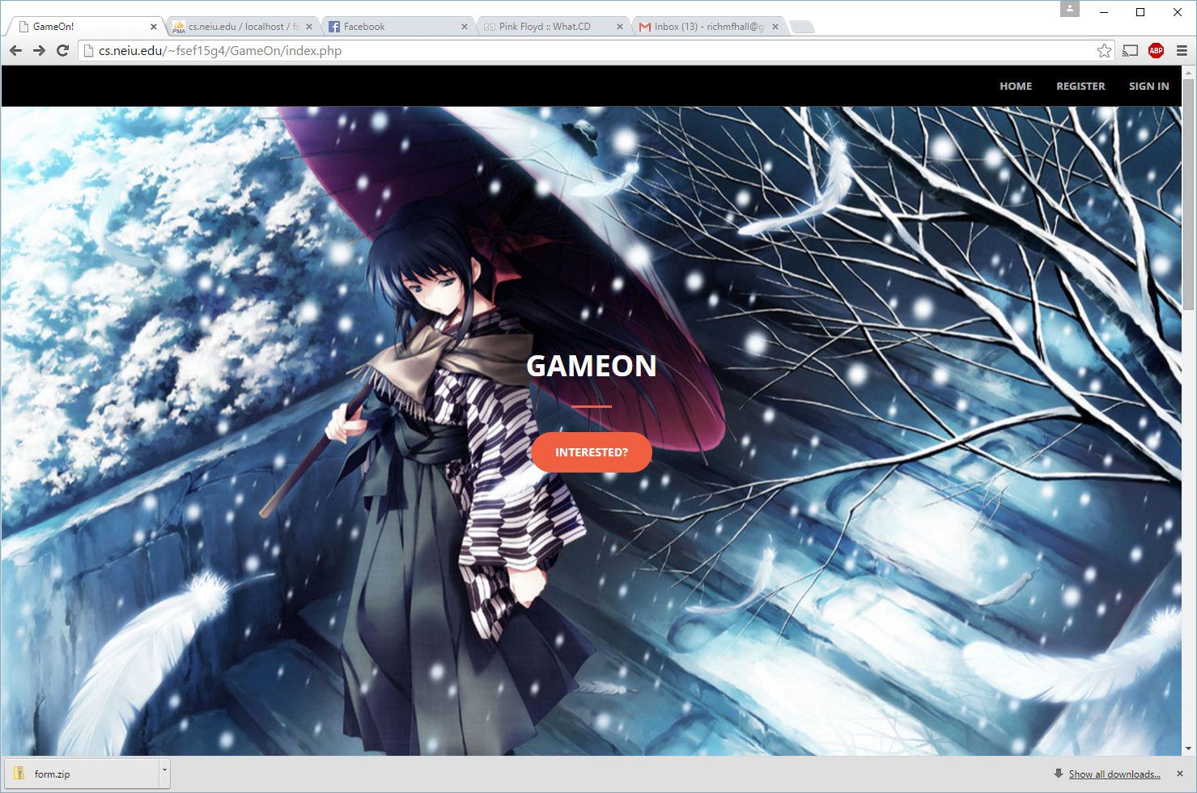
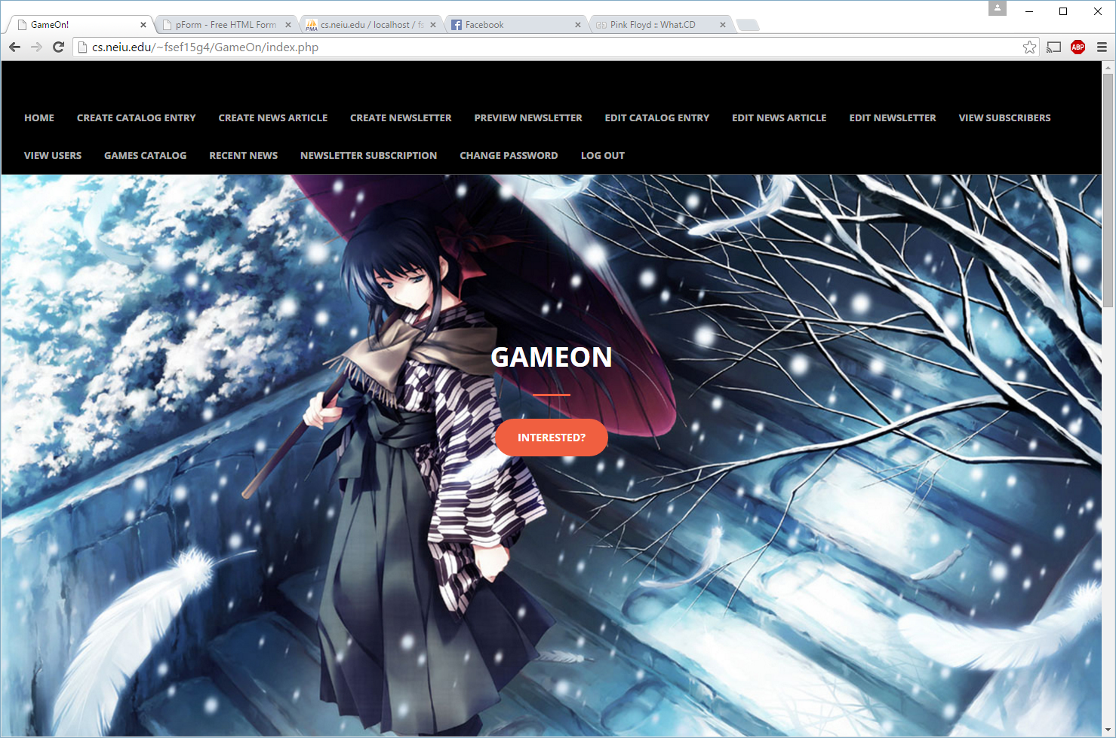
INITIAL VIEWS:
USER VIEW:
As seen from an internet user who is not logged into a php session.
ADMIN VIEW:
As seen from an internet user who is logged into a php session.

Slide 5
System failures:
Our website is still under construction which means you cannot see some tabs yet, but in the future this issue will be resolved as soon as possible.
There are also some slight errors that need to be fixed, but will not interfere with user needs, or admin need.
From an administrator view, there is some difficult navigation issues, which will be resolved as soon as possible also. The navigation bar will be cleaned up to provide better access to administrator needs

